Slide 1

Programming 101
Programming for non-programmers.
You will need Python 2.7.10
Go to https://www.python.org/downloads/
Click , download it and install it.

Slide 2
Last Time
We learned to:
Read and write code
Use the building blocks of a program
Name and describe different data types
Print output to the user
Get input from the user

Slide 3
Objectives
This time, you will be able to:
Name two types of loop
Understand the uses for each
Use the two types of loop
Use conditional statements
Choose one ‘code path’ over another depending on a value

Slide 4
As Always, Bear In Mind…
Programming is more of a skill than a subject.
Even if you memorise all the books, your first driving lesson isn’t going to be perfect.
Reading code is easier if you read right to left.
Think ‘6 = 3 + 3’ rather than ‘3 + 3 = 6’.
Mistakes are useful.
The more you make, the more you learn.
I’m going to show you more than you need to know.
It may not seem important, but it will help you find problems later.

Slide 5
Participation
Feedback is useful
Stop me if you get confused.
This is not a classroom
If you need to leave, that’s obviously OK.

Slide 6

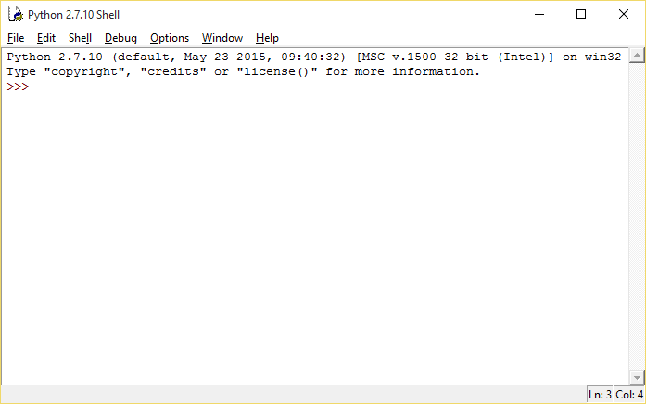
Open Python
Open IDLE (Python GUI)
IDLE stands for Integrated DeveLopment Environment

Slide 7
Functions
We used built-in functions last time:
print(“Hello, World!”)
type(“Text”)
raw_input(“Type something. ”)
input(“Give me a number. ”)
And used variables to store the results:
tenButAsText = str(10)
giveMeDecimalPlaces = float(45)
numberForLetterAInASCII = ord(‘a’)
theLetterA = chr(97)
letterAUsingNestedFunctions = chr(ord(‘a’))

Slide 8
Lists
What if we want to store lots of results in one place, under one name?

Slide 9
Lists
What if we want to store lots of results in one place, under one name?
Data can be grouped into arrays, or ‘lists’.
There are also functions for numeric lists:
range(a) or range(a, b, c) create a list of numbers
max(), min(), sum(), etc. can also be used

Slide 10

The range() function
Calling range() produces a list of numbers.
range(10)
range(5, 15)
range(0, 100, 10)

Slide 11
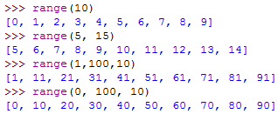
The range() function
Lists are shown in python by [square brackets].

Slide 12
The range() function
More examples:
print range(10)
print range(1,11,2)
print range(15,-3,-5)

Slide 13
Lists
You can store any type of data in a list. E.g. strings, integers and booleans:
questions = [‘2 + 2’, ‘9 - 4’, ‘3 - 6’]
myAnswers = [4, 5, 9]
studentAnswers = [4, 6, 3]
studentCorrect = [True, False, False]

Slide 14
Complex Lists
Python is special because it can store different types of data in a single list.
questions = [‘2 + 2’, ‘9 - 4’, ‘3 - 6’]
myAnswers = [4, 5, 9]
studentAnswers = [4, 6, 3]
studentCorrect = [True, False, False]
You can store several types at once, so if you were designing a report card:
reportQuestion1 = [‘2 + 2’, 4, 4, True]
reportQuestion2 = [‘9 - 4’, 5, 6, False]

Slide 15
If…ElseIf…Else: Conditions
It is possible to change what happens under certain conditions.
We use logical operators when doing comparisons:
+, -, *, /, etc. are mathematical operators
<, ≤, =, !=, <>, >, ≥ are relational operators
and and or are conditional operators

Slide 16
If…ElseIf…Else: Conditions
It is possible to change what happens under certain conditions.
We can say what to do:
if something is true
otherwise if (else if) something is true
what else to do if none of those are true

Slide 17
If…ElseIf…Else: Conditions
It is possible to change what happens under certain conditions.
These conditions can be simple or complicated, and use logical operators:
password == “letMeIn123”
answer != False
user == “Drew” and password == “password”
(funds > 0 and funds > price) or overdraft == “yes”

Slide 18
If…ElseIf…Else: Controlling the Execution Path
Let’s say we’re writing code for a game where you can only turn right.
The user enters a heading to follow.
If the heading entered is greater than 180, it will take us left.
If the angle is less than 0, the program will break.
So we have to change what the code does in different situations:
If the angle is less than 0, change it to 0.
If the angle is more than 180, change it to 180.

Slide 19
If…ElseIf…Else: Controlling the Execution Path
minAngle = 0
maxAngle = 180
angle = input(“Which way do you want to go? ”)
if angle < 0:
angle = minAngle
print(“You can’t go that way.”)
elif angle > 180:
angle = maxAngle
print(“You can’t go that way.”)
else:
print(“Go go go!”)

Slide 20
Conditions
minAngle = 0
maxAngle = 180
angle = input(“Which way do you want to go? ”)
if angle < 0:
angle = minAngle
print(“You can’t go that way.”)
elif angle > 180:
angle = maxAngle
print(“You can’t go that way.”)
else:
print(“Go go go!”)

Slide 21
Don’t forget to indent
minAngle = 0
maxAngle = 180
angle = input(“Which way do you want to go? ”)
if angle < 0:
angle = minAngle
print(“You can’t go that way.”)
elif angle > 180:
angle = maxAngle
print(“You can’t go that way.”)
else:
print(“Go go go!”)

Slide 22
Bonus: Logic Tables
NOT | T | F
 | False | True

Slide 23
Bonus: Logic Tables
NOT | T | F
 | False | True
OR | T | F
T | True | True
F | True | False
AND | T | F
T | True | False
F | False | False

Slide 24
If…ElseIf…Else: Conditions
user = raw_input(“What’s your name? ”)
angle = input(“What’s your heading? ”)
if user == “Drew” and angle < 0:
print(“You should know better”)
elif user != “Drew” and (angle < 0 or angle > 180):
#Change angle

Slide 25
Summary
If-ElseIf-Else
Comes in if, if-else, and if-elseif-else flavours.
Used to control which pieces of code are run in different circumstances.
Can have any number of logical checks in any order
Uses relational and conditional operators

Slide 26
Questions?

Slide 27
Loops
Computers can process the same thing thousands of times.
This is called looping and there are two types.
for loops do things a certain number of times
for i in range(10): for letter in “Hello”:
print(i) print(letter)
while loops do things while a condition is true
i = 1
while i < 10:
i = i + 1
print(i)

Slide 28
Loops
Computers can process the same thing thousands of times.
This is called looping and there are two types.
for loops do things a certain number of times
for i in range(10): for letter in “Hello”:
print(i) print(letter)
while loops do things while a condition is true
i = 1
while i < 10:
i = i + 1
print(i)
Note the colons ( : )

Slide 29
Loops
Computers can process the same thing thousands of times.
This is called looping and there are two types.
for loops do things a certain number of times
for i in range(10): for letter in “Hello”:
print(i) print(letter)
while loops do things while a condition is true
i = 1
while i < 10:
i = i + 1
print(i)
The gaps are also very important. This is how Python knows which lines are part of the loop and which lines are not.

Slide 30
Loop Control
Loops can also be broken or continued.
For example, if a point in a loop is reached where it’s pointless going any further, you can call the break statement.
for i in range(100): while i < 10:
print(i + 5) print(i + 5)
break i += 1
break

Slide 31
Loop Control
Loops can also be broken or continued.
For example, if a point in a loop is reached where it’s pointless going any further, you can call the break statement.
for i in range(10): while i < 10:
print(i + 5) print(i + 5)
break i += 1
break

Slide 32
Loop Control
Loops can also be broken or continued.
If you’ve done all you can with a certain value and want to start with the next one, you can continue.
for i in range(10): while i < 10:
print(i + 5) print(i + 5)
continue i += 1
continue

Slide 33
Loop Control
Loops can also be broken or continued.
If you’ve done all you can with a certain value and want to start with the next one, you can continue.
for i in range(10): while i < 10:
print(i + 5) print(i + 5)
continue i += 1
continue

Slide 34
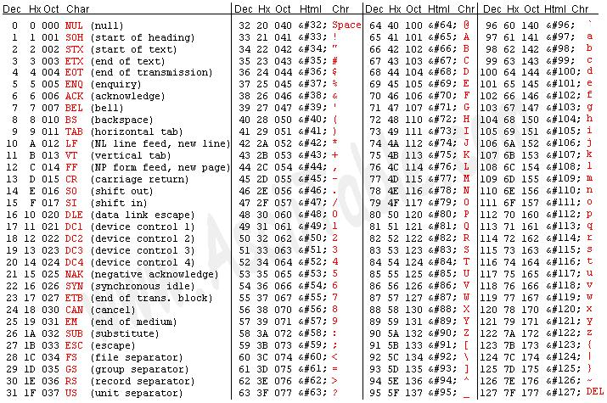
ASCII
American Standard Code for Information Interchange

Slide 35
Quick Break
Lots of languages are developing shortcuts for loops
Run the following:
n = range(48,127)
print n
k = [[c,chr(c)] for c in n]
print k
Question:
What does it do?

Slide 36
Application of Loops: Complex Series
1, 1, 2, 3, 5, 8, 13, 21, 34...
The next number is always the sum of the previous two.

Slide 37
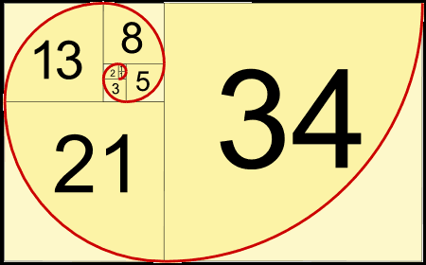
Fibonacci
1, 1, 2, 3, 5, 8, 13, 21, 34...

Slide 38
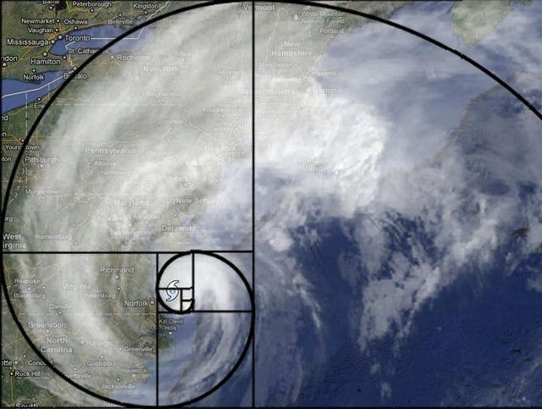
Fibonacci

Slide 39
Fibonacci
This code creates the values in the Fibonacci series:
f = [1, 1]
f = f + [ f[ -2 ] + f[ -1 ] ]
We’re always taking two values; the second-to-last and the last.

Slide 40
Fibonacci
This code creates the values in the Fibonacci series:
f = [1, 1]
f = f + [ f[ -2 ] + f[ -1 ] ]
f = f + [ f[ -2 ] + f[ -1 ] ]
f = f + [ f[ -2 ] + f[ -1 ] ]
f = f + [ f[ -2 ] + f[ -1 ] ]
f = f + [ f[ -2 ] + f[ -1 ] ]
f = f + [ f[ -2 ] + f[ -1 ] ]
f = f + [ f[ -2 ] + f[ -1 ] ]
f = f + [ f[ -2 ] + f[ -1 ] ]
f = f + [ f[ -2 ] + f[ -1 ] ]
The same operation is done over and over.
We may as well loop.

Slide 41
Fibonacci
This code creates the values in the Fibonacci series:
f = [1, 1]
f = f + [ f[ -2 ] + f[ -1 ] ]
The same operation is done over and over.
We may as well loop.

Slide 42
Fibonacci
This code creates the values in the Fibonacci series:
f = [1, 1]
for i in range(10):
f = f + [ f[ -2 ] + f[ -1 ] ]
The same operation is done over and over.
We may as well loop.

Slide 43
Fibonacci
This code creates the values in the Fibonacci series:
f = [1, 1]
for i in range(10):
f = f + [ f[ -2 ] + f[ -1 ] ]

Slide 44
Fibonacci
This code creates the values in the Fibonacci series:
f = [1, 1]
for i in range(10):
f = f + [ f[ -2 ] + f[ -1 ] ]
This is a statement, so we have to print out the values ourselves.
print(f)
or
for n in f:
print(n)

Slide 45
Summary
Loops
Useful for repetitive tasks
Complex series, games, artificial intelligence
Can be broken or continued
‘For’ Loops
Do the same thing a limited amount of times
‘While’ Loops
Check a condition each time and loop again if it is true

Slide 46
Questions?

Slide 47
Your Turn
That’s all the learning for this week.
As I said at the beginning, the best way to learn it is to do it.
Make mistakes, ask for help.

Slide 48
Quick Challenge
Make a list that holds:
a question
an answer
whether or not it’s correct
Ask each question, store their answer, and tell the user whether they’re correct.

Slide 49
Well Done!
Thank you for coming. I hope you enjoyed yourself.
If you want to try some more:
These slides will be made available online
There is a book: “Think Python – How to Think Like a Computer Scientist”
Free from http://www.greenteapress.com/thinkpython/thinkpython.pdf
You can learn for free on Code Academy
They do lots of courses, including one on Python

Slide 50
The Learning Wheel
DK K
DK DK
K DK
K K
Know you know
Don’t know you don’t know
Don’t know you know
Know you don’t know

Slide 51
KWD
Know | Want to know | Don’t know

